Slide 1
Shell Scripting
Arrays and Functions

Slide 2
Arrays

Slide 3
What is an array?
An array is a single variable that can hold multiple values (a collection). In Bash, arrays are indexed (numeric indices starting from 0) or associative (string keys, Bash 4+).
Indexed arrays: arr=(a b c)
Associative arrays: declare -A map (Bash 4+)
Note: Arrays are a Bash feature. Portable /bin/sh scripts typically do not support arrays.
Why use arrays?
Store lists (filenames, user names, numbers) in one variable.
Easier iteration and batch processing.
Better structure than many separate scalar variables.

Slide 4
Creating (declaring) arrays
Explicit assignment (preferred shorthand)
# Create an indexed array with four elements
arr=(apple banana cherry "fruit salad")
Assign element-by-element
# Put value into index 0
arr[0]=apple
arr[1]=banana
arr[5]=grape
Declare an empty array and append later
declare -a list # optional: declare as an indexed array (for clarity)
list=() # empty array
list+=(one) # append 'one'
list+=(two three)
Create array from command output
arr=(red green blue)
echo "\${arr[0]}" # prints 'red'
echo ${arr[@]} # word-splits and expands each element
echo "\${arr[@]}" # each element preserved as a single word
echo "\${arr[*]}" # joins elements with first character of IFS (default space)

Slide 5
Useful array properties and operations
arr=(10 20 30 40)
echo "Length = ${#arr[@]}" # prints 4
echo "Indices = ${!arr[@]}" # prints "0 1 2 3"
unset 'arr[2]'
arr+=(50)
arr[1]=99

Slide 6
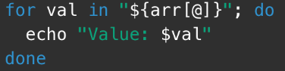
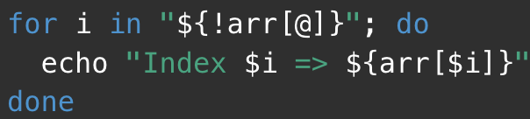
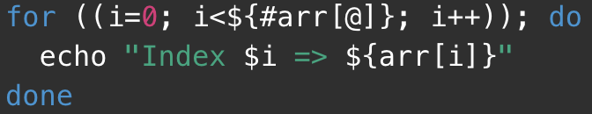
Iterating over arrays
Iterate over values
Iterate over indices
C-style loop (index math)

Slide 7
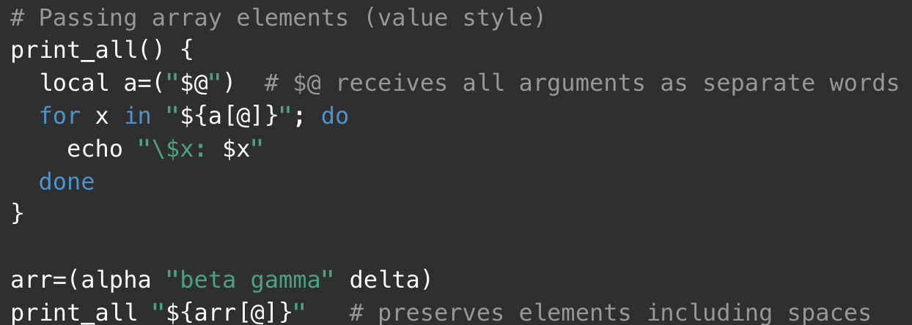
Passing arrays to functions (by reference vs by value)

Slide 8
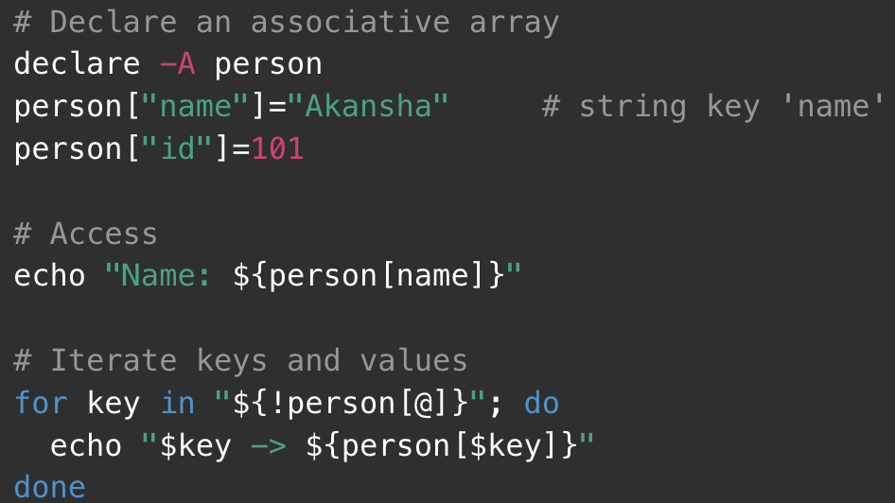
Associative arrays (Bash 4+)

Slide 9
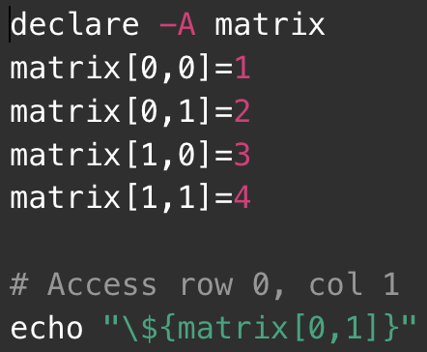
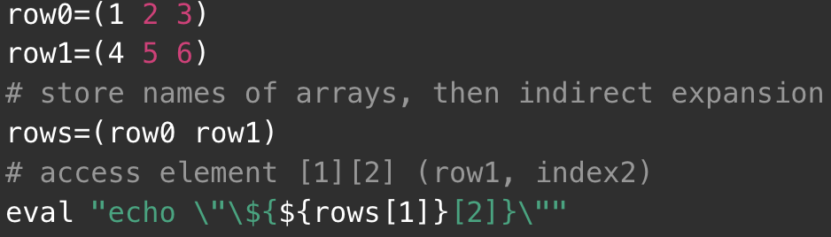
Simulating multi-dimensional arrays
Associative array with compound keys
Array-of-arrays

Slide 10
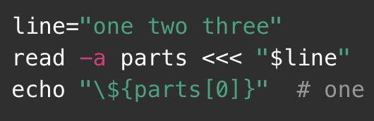
Converting a string to an array (splitting)

Slide 11

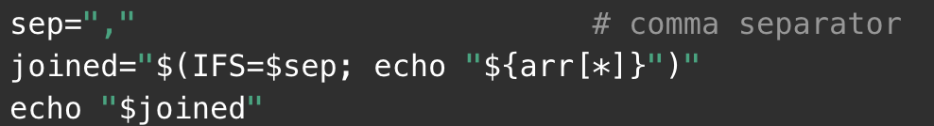

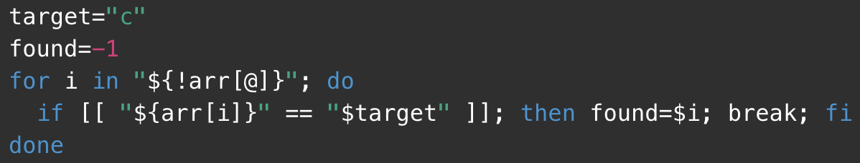
Common operations & tricks
Print with printf
Join array into string with a custom separator:
Slice array (get subset):
Search for value (linear)

Slide 12
Some Examples
#!/usr/bin/env bash
files=( *.txt ) # glob expansion: list of filenames
echo "Found ${#files[@]} text files" # ${#files[@]} = length
for f in "${files[@]}"; do
echo "Processing: $f"
wc -w "\$f" done

Slide 13
Example
#!/usr/bin/env bash
declare -A marks # declare associative array
marks["Alice"]=82 # set value for key 'Alice'
marks["Bob"]=90
marks["Charlie"]=75
for student in "${!marks[@]}"; do
echo "$student => ${marks[$student]}"
done

Slide 14
Functions
To avoid large and complicated scripts use functions.
You divide large scripts into a small chunks/entities called functions.
Functions makes shell script modular and easy to use.
Function avoids repetitive code. For example, is_root_user() function can be reused by various shell scripts to determine whether logged on user is root or not.
Function performs a specific task. For example, add or delete a user account.
Function used like normal command.
In other high level programming languages function is also known as procedure, method, subroutine, or routine.

Slide 15
Writing the hello() function
Type the following command at a shell prompt:
Invoking the hello() function
hello() function can be used like normal command. To execute, simply type:
hello
Passing the arguments to the hello() function
You can pass command line arguments to user defined functions. Define hello as follows:
You can hello function and pass an argument as follows:
hello Vivek
Sample outputs:
Hello Vivek, let us be a friend.
## NOTE:
One line functions inside { ... } must end with a semicolon. Otherwise you get an error on screen:
xrpm() { rpm2cpio "$1" | cpio -idmv }
Above will not work. However, the following will work (notice semicolon at the end):
xrpm() { rpm2cpio "$1" | cpio -idmv; }

Slide 16
Displaying functions
To display defined function names use the declare command. Type the following command at a shell prompt:
declare -f
Sample outputs:
declare -f command_not_found_handle
declare -f genpasswd
declare -f grabmp3
declare -f hello
declare -f mp3
declare -f xrpm

Slide 17
Display Function Source Code
To view function names and source code, enter:
declare –f OR declare -f | less
To view a specific function source code, enter:
declare -f functioName
declare -f xrpm
Notice if you just type the declare command with no arguments, then it will list all declared variables and functions.
Removing functions
To unset or remove the function use the unset command as follows:
unset -f functionName
unset -f hello
declare

Slide 18
Defining functions
name() compound_command
OR
function name {
command1
command2
}
OR
function name() {
command1
command2
}

Slide 19
One Line Functions Syntax
One line functions inside { ... } must end with a semicolon:
function name { command1; command2; commandN;}
OR
name() { command1; command2; commandN;}
where name is the name of the function, and "command1; command2;" is a list of commands used in the function.
You need to replace name with actual function name such as delete_account:
rollback(){
...
}
add_user(){
...
}
delete_user(){
...
}

Slide 20
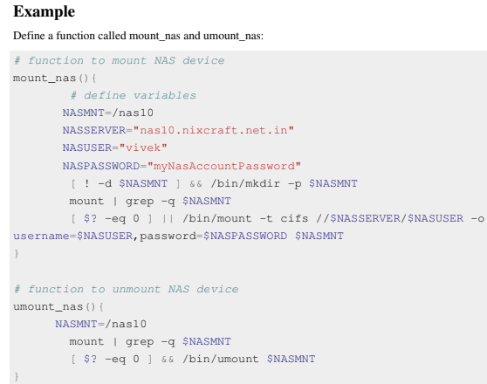

Slide 21
Writing functions
Write shell function:
name() {
command list;
}
The idea is very simple create a modular scripts.
Place frequently used commands or logic in a script.
You can call the function whenever it is required rather writing or repeating the same code again.
You can create a functions file: /etc/init.d/functions
is default functions file which contains functions to be used by most or all shell scripts in the /etc/init.d directory. This file can be autoloaded as and when required.
You can view /etc/init.d/functions file with the following command:
less /etc/init.d/functions

Slide 22
All shell functions are treated as a command.
You must define a function at the start of a script.
You must load a function file at the start of a script using source (or .) command:
. /path/to/fuctions.sh
OR
source /path/to/fuctions.sh
You can call function like normal command:
name
name arg1 arg2

Slide 23
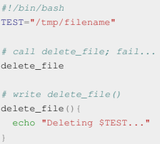

Write a function at the start of a script
A function must be created before calling. For example, the following script (ftest.sh) will fail:

Slide 24
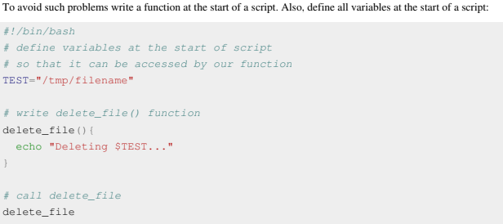

Slide 25
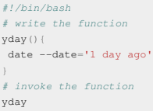
Calling functions
To call or invoke the function, type the name of the function:
functioName
For example, define and write a function called yday() to display yesterday's date:
To invoke the function yday(): yday
In the end the program should like as follows:

Slide 26
Pass arguments into a function
Shell functions have their own command line argument.
Use variable $1, $2..$n to access argument passed to the function.
The syntax is as follows:
name(){
arg1=$1
arg2=$2
command on $arg1
}
To invoke the function use the following syntax:
name foo bar
Where,
1. name = function name.
2. foo = Argument # 1 passed to the function (positional parameter # 1).
3. bar = Argument # 2 passed to the function.

Slide 27
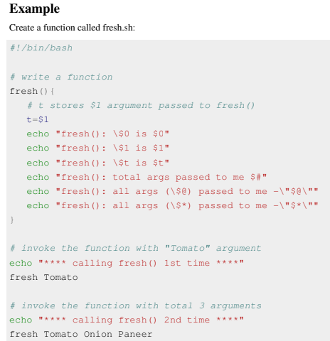


Slide 28
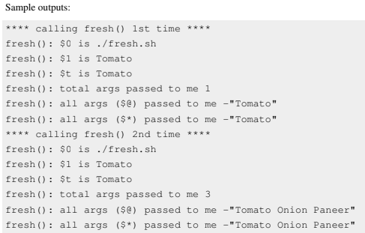

Slide 29
Function shell variables
All function parameters or arguments can be accessed via $1, $2, $3,..., $N.
$0 always point to the shell script name.
$* or $@ holds all parameters or arguments passed to the function.
$# holds the number of positional parameters passed to the function.
How Do I Display Function Name?
$0 always point to the shell script name. However, you can use an array variable called FUNCNAME which contains the names of all shell functions currently in the execution call stack. The element with index 0 is the name any currently-executing shell function. This variable exists only when a shell function is executing.

Slide 30
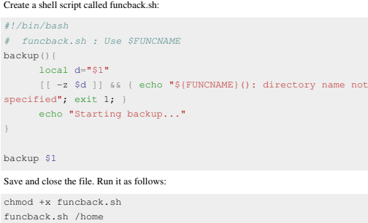
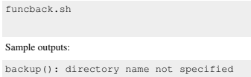

Slide 31
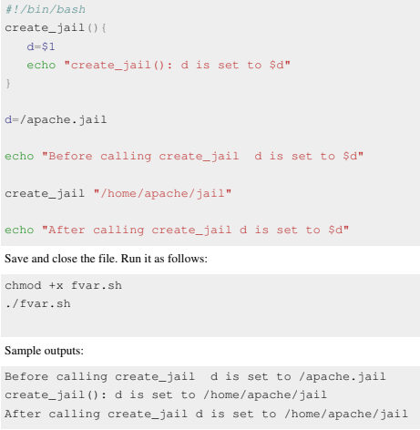
Local variable
By default all variables are global.
Modifying a variable in a function changes it in the whole script.
This can be result into problem. For example, create a shell script called fvar.sh:

Slide 32
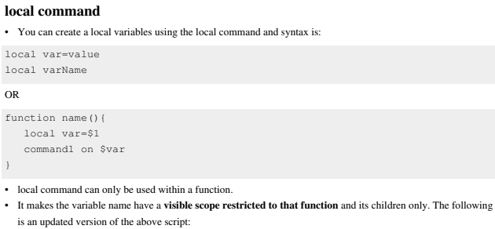

Slide 33
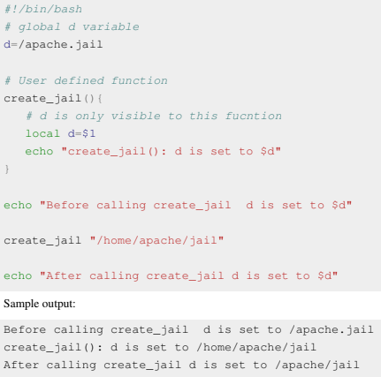

Slide 34
Returning from a function
In mathematics a function ƒ takes an input, x, and returns an output ƒ(x).
In computer a shell function name can take an input, $1 and return back the value (true or false) to the script.
In other words, you can return from a function with an exit status.
Syntax
The return command causes a function to exit with the return value specified by N and syntax is:
return N
If N is not specified, the return status is that of the last command.
The return command terminates the function.
The return command is not necessary when the return value is that of the last command executed.
Example
Create a shell script called isroot.sh as follows:

Slide 35
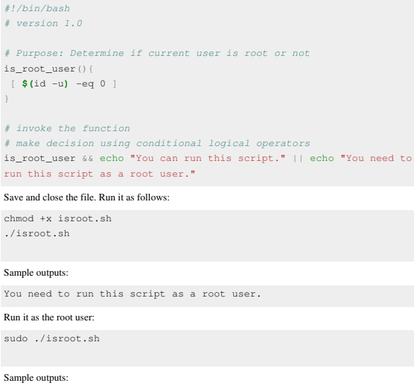


Slide 36
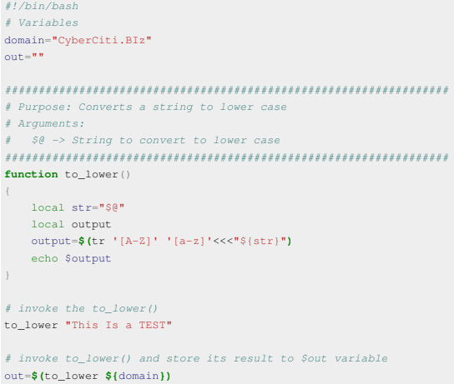
Returning a string or word from a function
You cannot return a word or anything else from a function.
However, you can use echo or printf command to send back output easily to the script.

Slide 37

Shell functions library
You can store all your function in a function files called functions library.
You can load all function into the current script or the command prompt.
The syntax is as follows to load all functions:
. /path/to/your/functions.sh
Source command
The source command can be used to load any functions file into the current shell script or a command prompt.
• It read and execute commands from given FILENAME and return.
• The pathnames in $PATH are used to find the directory containing FILENAME. If any ARGUMENTS are
supplied, they become the positional parameters when FILENAME is executed.
• The syntax is as follows:

Slide 38
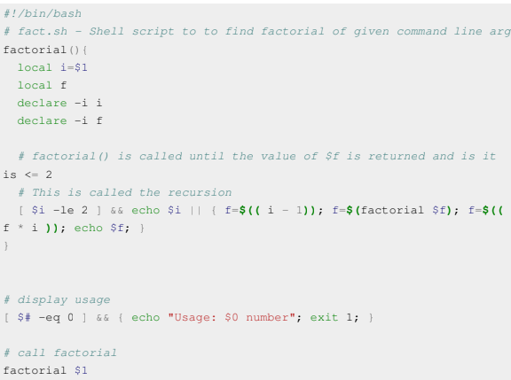
Recursive function
A recursive function is a function that repeatedly calls itself.
No limit is placed on the number of recursive calls.
Create a shell script called fact.sh:

Slide 39
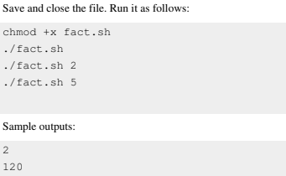
Recursive functions are slow under bash.
Avoid using recursive functions if possible.

Slide 40
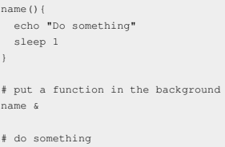
Putting functions in background
The & operator puts command in background and free up your terminal.
You can also put a function in background.
The syntax is as follows:

